Slide 1
Unit 7
How do you
lern English
Lesson 1

Slide 2
VOCABULARY

Slide 3
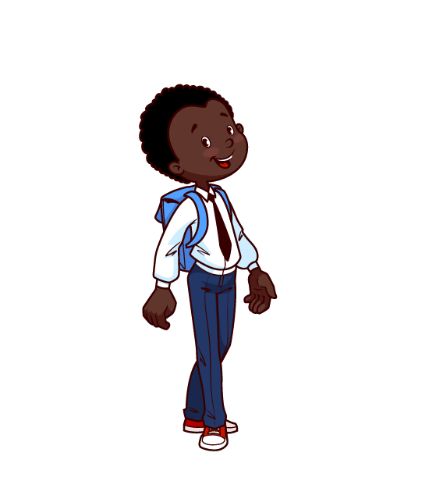
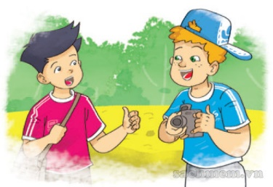
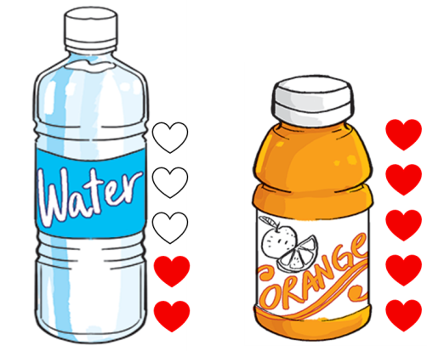
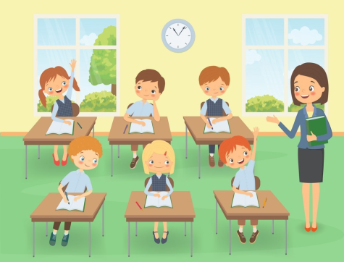
A. Vocabulary
French
English
French
language
foreign
/frentʃ/
/ˈlæŋɡwɪdʒ/
/ˈfɔːrən/
Tiếng Pháp
Ngôn ngữ
Nước ngoài
talk
favourite
learn
/tɔːk/
/ˈfeɪvərɪt/
/lɜːrn/
Nói chuyện
Yêu thích
Học

Slide 4
Choose the correct picture
a
b
c
d
language
French
English

Slide 5
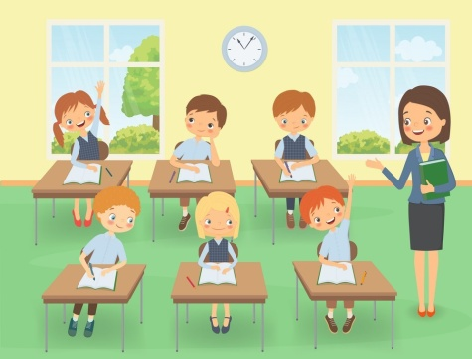
Choose the correct picture
a
b
c
d
French
French
English

Slide 6
Choose the correct picture
a
b
c
d
foreign
French
English

Slide 7
Choose the correct picture
a
b
French
English
c
d
favourite

Slide 8
Choose the correct picture
a
b
c
d
talk

Slide 9
Choose the correct picture
a
b
French
English
c
d
learn

Slide 10
GRAMMAR

Slide 11
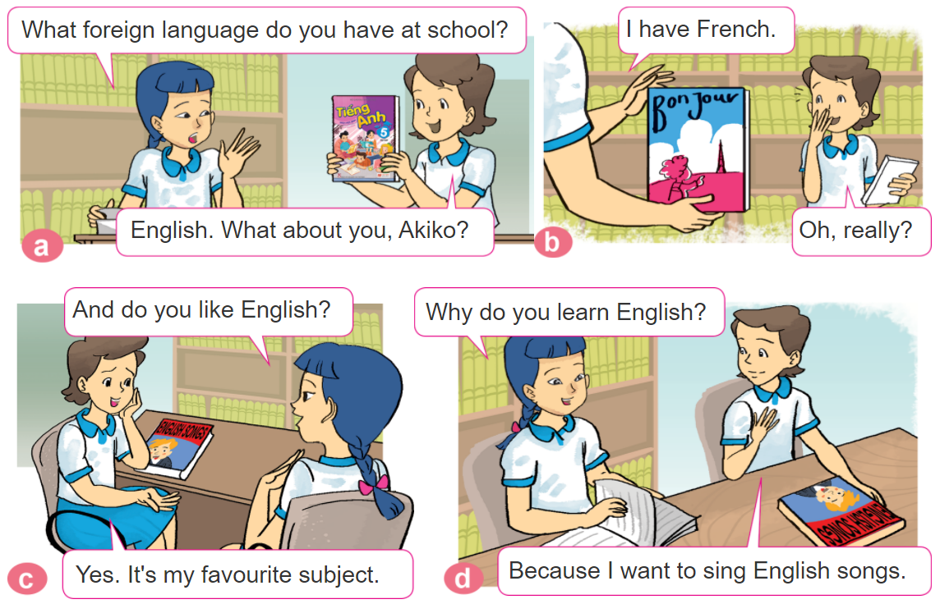
1. Look, listen and repeat.

Slide 12
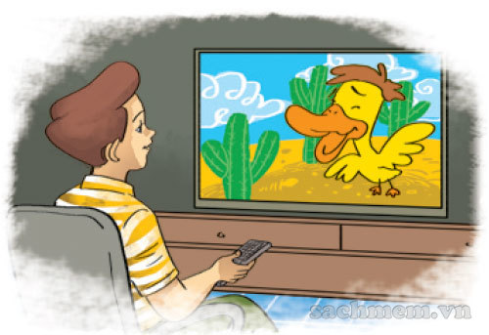
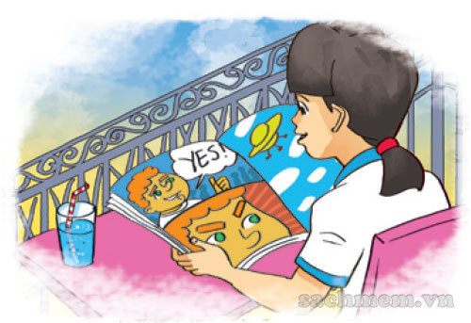
2. Point and say
Why do you learn English?
Because I want to __________.
watch English cartoons on TV
talk with my foreign friends
read English comic books

Slide 13
B. Grammar
Hỏi và trả lời vì sao bạn thích học Tiếng Anh:
(Tại sao bạn thích học Tiếng Anh)
Why do you learn English?
Because I want to ____________.
+ lí do thích học
(Bởi vì tớ muốn ______________)

Slide 14
3. Let’s talk
How do you
learn English?
I _____________
Because I want to ______.
Why do you learn English?

Slide 16
What
How
______ do you learn English?
Because I want to be an English teacher.
Why

Slide 17
Because I want to watch English cartoons on TV.
Because I want to talk with my foreign friends.
Why do you learn English?
Because I want to read English comic books.

Slide 18
Why do you learn nglish?
Because I want to watch English cartoons on TV.
Why do you learn English?
Because I want to talk with my foreign friends.

Slide 19
They is my friend
This is your friend
Why do you learn English?
This is my friend

Slide 20
How do you learn English?
Why do you learn English?
Because I want to
sing English song.
Do do you like to learn English?

Slide 21
do
are
How _____ you learn English?
were

Slide 22
I watch English cartoons on TV.
I read English comic books.
How do you
learn English?
I talk with my foreign friends.

Slide 23
I watch English cartoons on TV.
I talk with my foreign friends.
How do you
learn English?
I read English comic books.

Slide 24
I sing English song.
I talk with my foreign friends.
How do you
learn English?
I watch English cartoons on TV.

Slide 25
Time’s up!

Slide 26
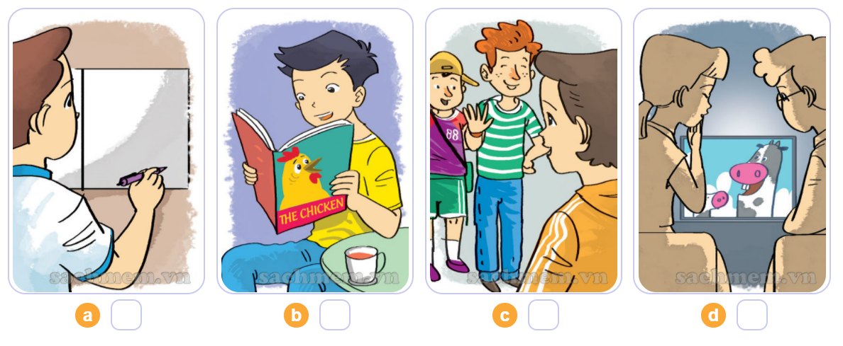
4. Listen and number
1
2
3
4

Slide 27
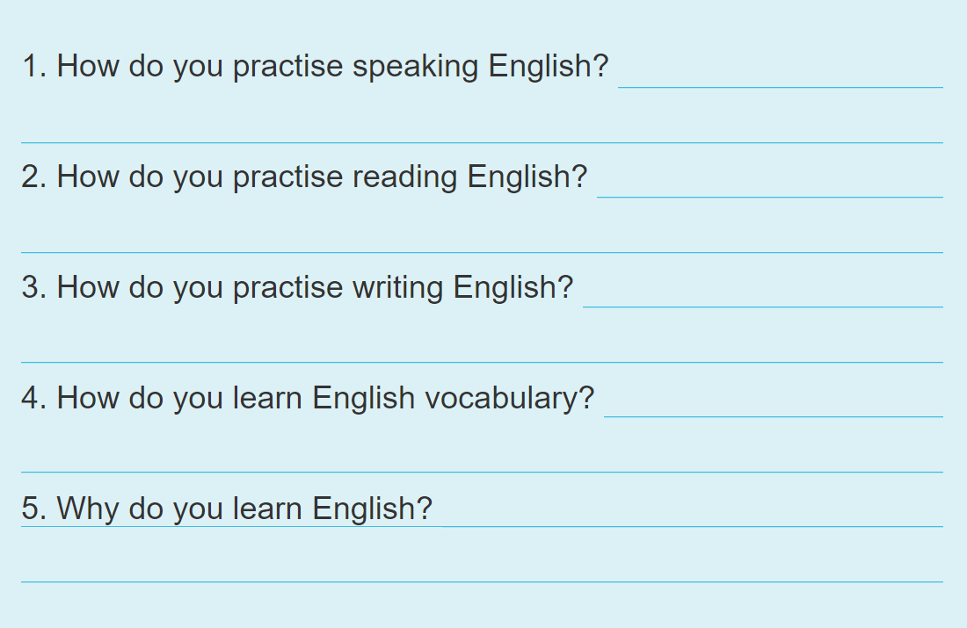
5. Write about you.

Slide 28
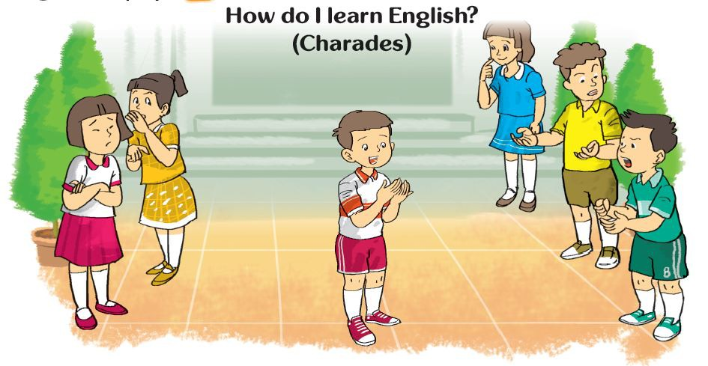
6. Let’s play

Slide 29
THANK YOU!
Welcome to join with me!

